Slide 1
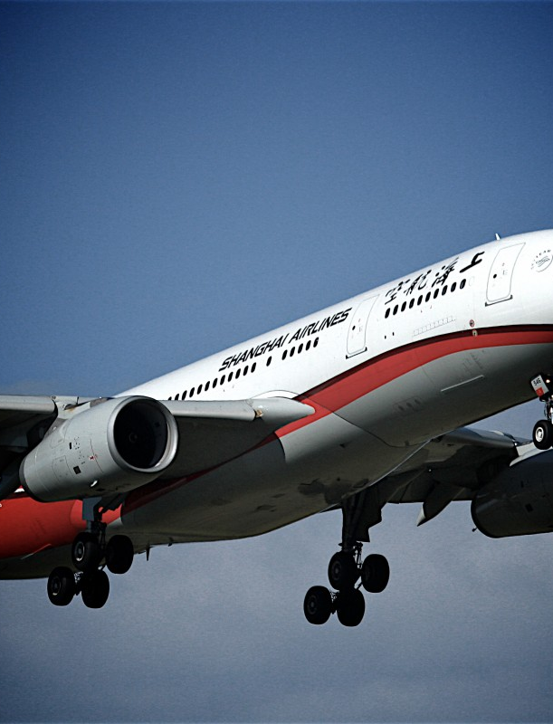
Aircraft Safety Risk Analysis
May 31, 2024

Slide 2
Summary
Analysis of a national aviation accident database assessing risk of injury for a variety of airplane models
Assesses risk based on fatal and non-fatal injury rates of aircraft models
Recommendation of three safest aircraft models, based on historical injury rates, for each of three passenger capacity classes (small, medium, large)

Slide 3
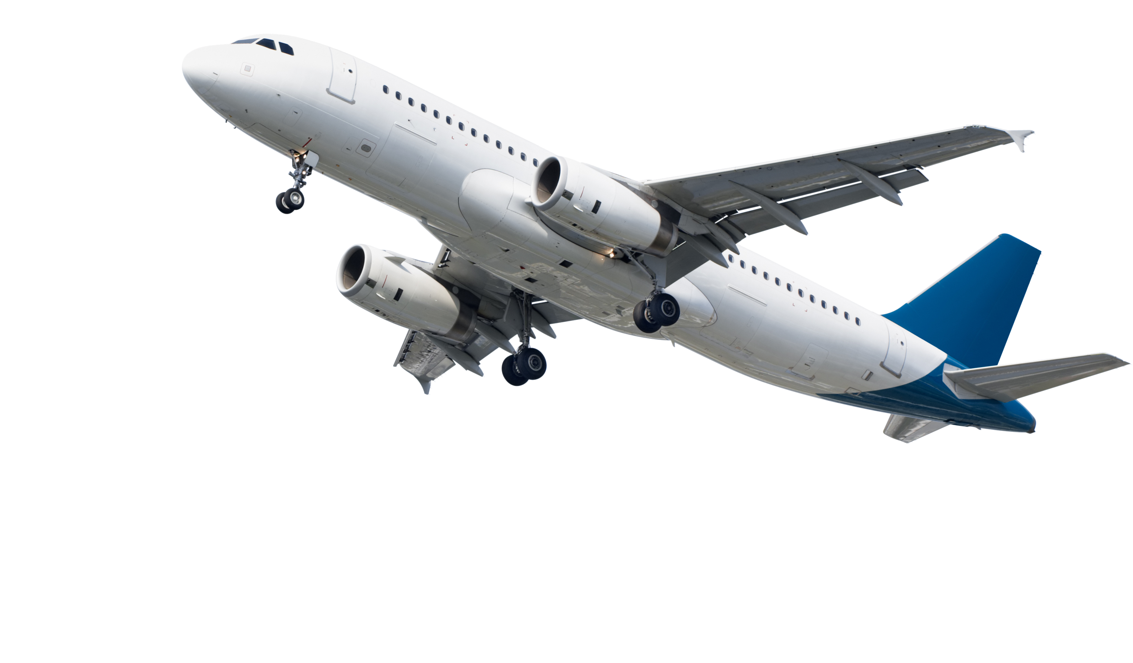
Outline
Business Problem
Data Analysis
Results
Conclusions

Slide 4
Business Problem
The company is interested in purchasing and operating airplanes for commercial and private enterprises and needs recommendation from a safety perspective.
This assessment will make and aircraft model recommendations based on historical injury outcomes; prioritizing minimizing fatal then non-fatal injury rates

Slide 5
Data Analysis
Data Source : National Transportation Safety Board (NTSB) aviation accident/incident database
Performed on 68,000 records of individual crash events spanning the U.S. from years 1982 to 2022
Assessment based on aircraft make, model, passenger capacity, injury rates (fatal and non-fatal)
Only aircraft models that had a history of at least 1000 total passengers involved in accidents were considered, narrowing the field to 36 different models

Slide 6
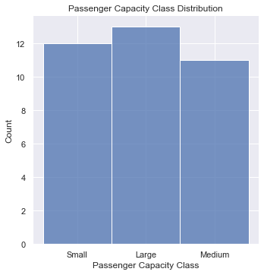
Results – Capacity Classes
1 – 2
Passenger
> 150
Passenger
70 - 150
Passenger

Slide 7
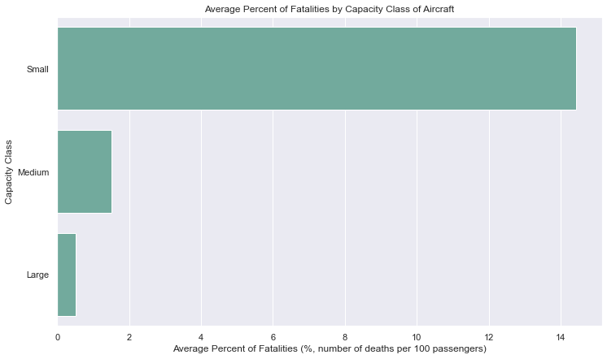
Results – Fatality Rates by Class
Smaller aircraft have a much higher potential for fatality than the larger counterparts

Slide 8
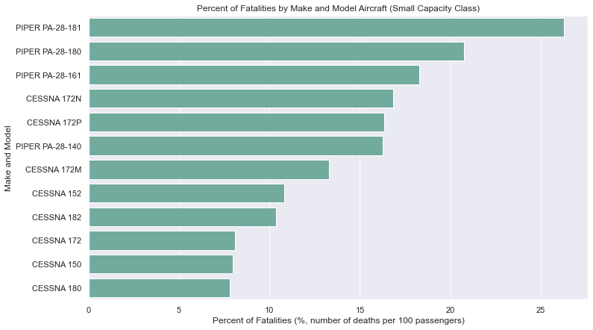
Results – Fatality Rates for Small Class Models
.
SAFEST

Slide 9
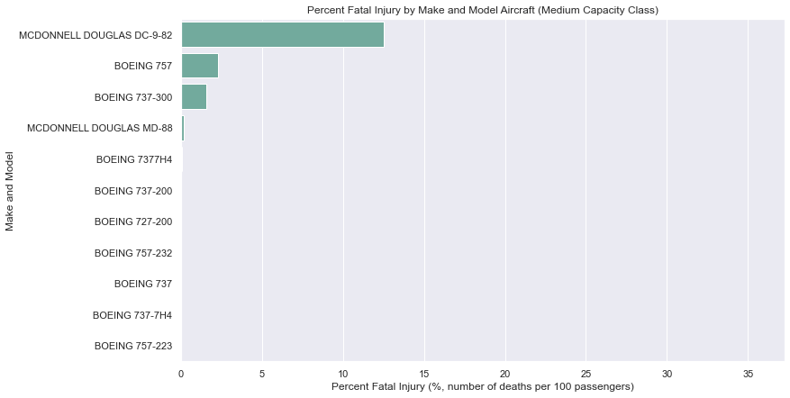
Results – Fatality Rates for Medium Class Models
No fatalities: drill down to non-fatal rates among these

Slide 10
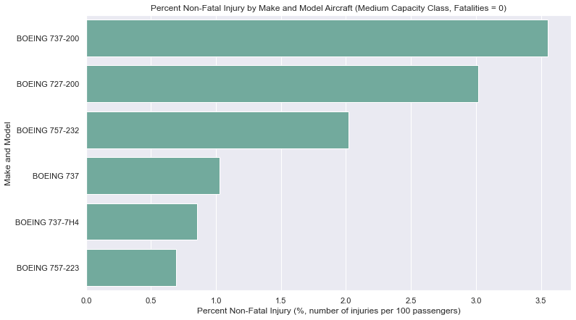
Results – Non-Fatal Injury Rates for Medium Class
SAFEST

Slide 11
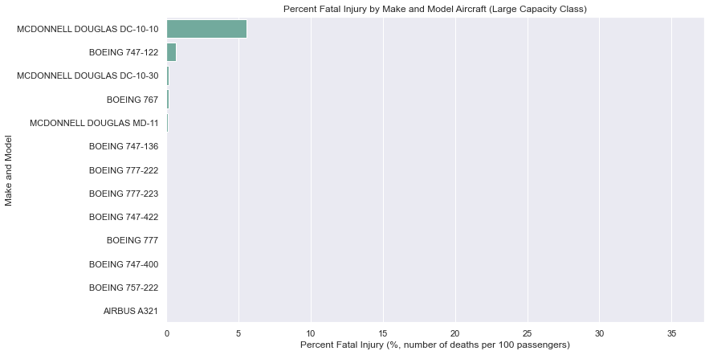
Results – Fatality Rates for Large Class Models
No fatalities: drill down to non-fatal rates among these

Slide 12
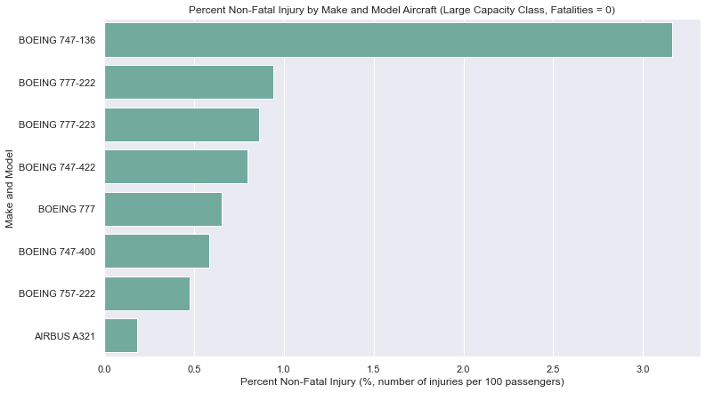
Results – Non-Fatal Injury Rates for Large Class
SAFEST

Slide 13
Conclusions
We do not recommend the use of Small Class planes because their fatality rate is much higher.
If necessary, safest aircraft are Cessna models 150, 172, 180
For Medium Class, we recommend the following models:
Boeing 737, 737-7H4, 757-223
For Large Class, we recommend the following models:
Boeing 757-222, 747-400
Airbus A321
Next Steps:
Analyze geographic location effects for recommended models to optimize safety
Acquire non-accident flight record data to analyze the volume of safe flights by model and potential markets
Return on Investment (ROI) analysis based on MSRP data, purchase availability and loan rates for safe model recommendations

Slide 14
Thank You
Please direct any questions you may have to Dale Deford and James Warsing
Dale Deford: daledeford@gmail.com
Github:
James Warsing: warsingjt@gmail.com
Github: james-warsing

